Slide 1
BIODIVERISTY CAPSTONE PROJECT - INVESTIGATING PROTECTED SPECIES

Slide 2
Contents
Description of data provided in species_info.csv.
Significance calculations for the endangered status between different categories of species and recommendation for conservationists.
Sample size determination for the foot and mouth disease study
Graphs
Graphs cont.
Comments regarding data source

Slide 3
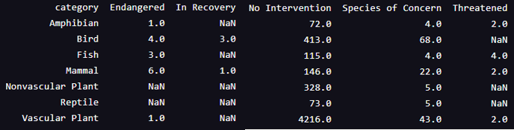
Description of data provided in species_info.csv
The information in provided in species_info.csv lists the various species present in the parks. It groups them by category and conservation status.
The types are:
Mammals, birds, reptiles, amphibians, fish, vascular plants and non-vascular plants.
The conservations statuses are:
Endangered, In Recovery, Species of Concern, Threatened, No Intervention
Calculations were performed on the data provided to determine the likelihood of a category being endangered.
A breakdown of the information is summarised below:

Slide 4
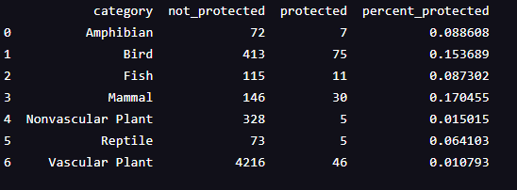
Significance calculations for endangered status between different categories of species.
From the chart below, we can see that mammal and birds are the categories with the highest percent protected. To determine if the difference was significant we conducted a significance test. Our null hypothesis was that this difference was by chance. A chi-squared test was chosen. Mammals and birds were compared and the result showed that, with a pval result of 0.6876 the difference was not significant as it was greater than 0.05 which was the basis of our null hypothesis. So this difference was a result of chance.
Amphibians were tested and the result was also not significant with a result of 0.12.
When the reptiles were tested, the difference however was significant coming in at a pval of 0.038 which is below the 0.05 used as the basis.
Recommendation to conservationists
Therefore we can conclude that some species are more likely to be endangered than others. Conservationists need to continue with their work in order to determine what is causing the increased likelihood of being classed endangered and what can be done to reduce this and protect these species.

Slide 5
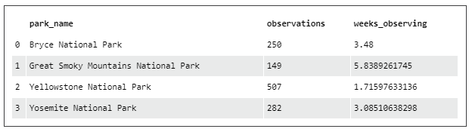
Sample size determination for the foot and mouth disease study
The Park Rangers want to be able to detect at least a 5 percent point reduction in the cases of Foot and Mouth in the parks. Last year 15% of the sheep had this disease.
Using a baseline of the 15%, a 90% level of significance and the 5% change they would like to detect, the sample size required is 870 sheep. With the observations noted over the course of one week at the various parks (shown in chart below) the time needed to observe the required number of sheep is calculated in the ‘weeks_observing’ column.

Slide 6
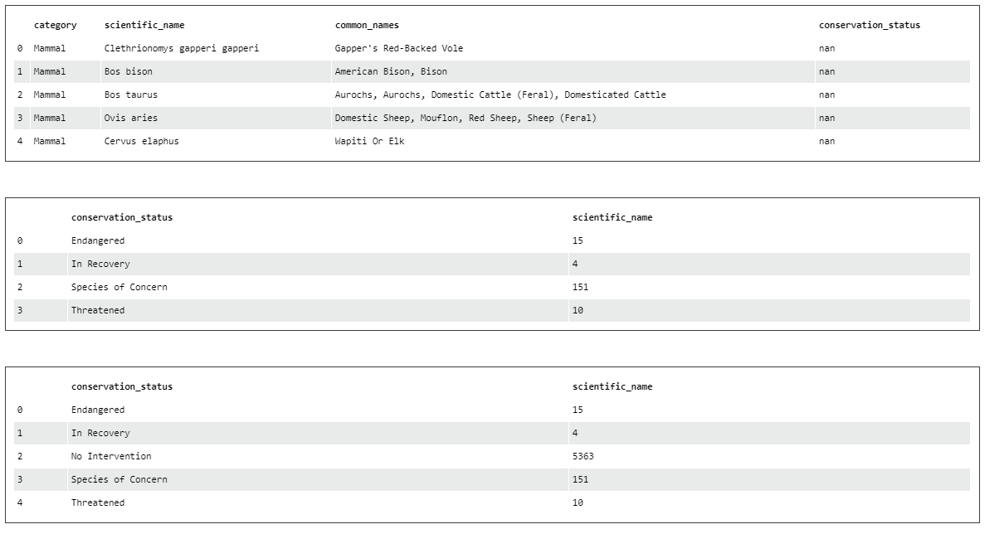
Additonal graphs not included in previous sections.
Groupby calculations do not recognise entries equal to ‘none’ so it is useful to fill these with measurable content. In the case of the 2 lower charts here, we can see the difference in result when the ‘none’ entries have been replaced with ‘No Intervention’. It helps to give an accurate view of the number of species in the parks as a whole.

Slide 7
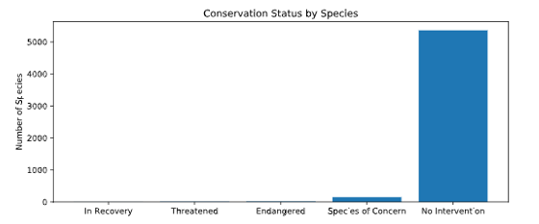
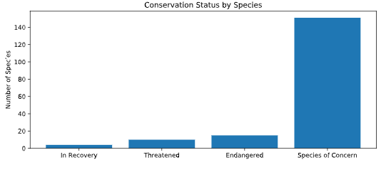
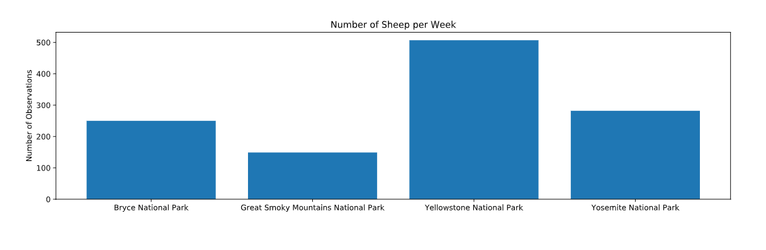
Additional charts, cont.
The ‘Conservation Status by Species’ bar chart to the right, which was run using the full species information is not very informative as the ‘No Intervention’ category is overwhelming the other categories.
When this is run again without the ‘No Intervention’ category it is more useful as the other statuses are now represented on the chart.
The chart below was run on the observations information. This shows the number of sheep observed in the various parks over a week and is used to calculate the number of weeks needed at each site to observe the required number of sheep for the Foot and Mouth study.

Slide 8
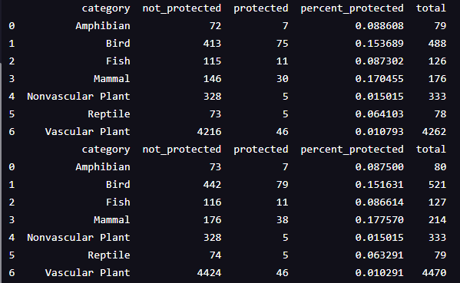
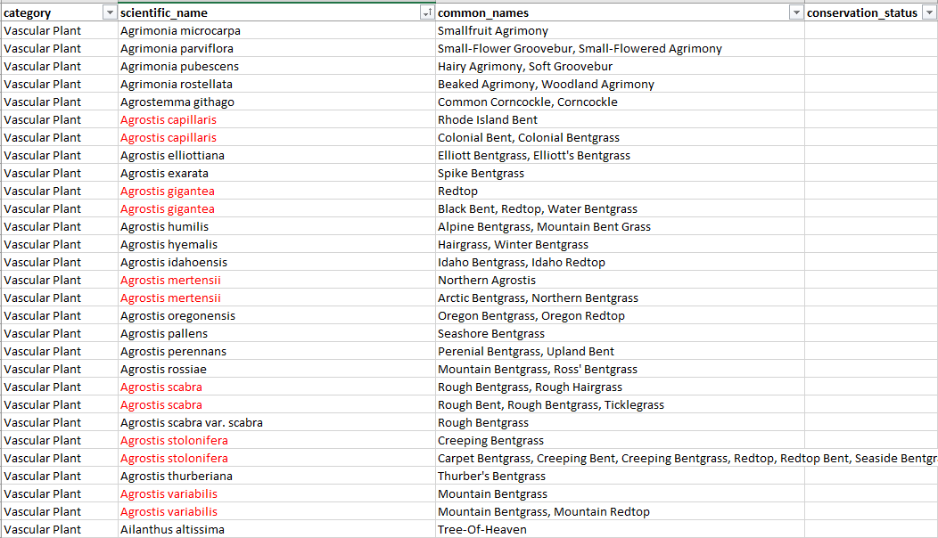
Comments re: data source
When attempting to run additional analysis on the overall number of entries by scientific_name in the species_info.csv it became clear that there were many duplicates, as is shown in red in the screenshot below. This meant I needed to access the excel spreadsheet to determine where the problem lay. For future / ongoing analysis I would recommend that the source data be cleaned to remove any duplicate entries. This will ensure that all analysis carried out is accurate.
Results excluding duplicates
Results including duplicates

